Slide 1

Sales and Real Estate
Canada
Dataset: - https://www.kaggle.com/datasets/reenapinto/housing-price-and-real-estate-2023

Slide 2

Table of Contents
Overview of Dataset
My Observations
Graphs
Conclusions

Slide 3

Housing Price & Real Estate - 2023
A housing market prediction that many experts agree on is that it will be a seller’s market. Home prices are expected to rise for some time due to increased demand and limited supply. Millennials are at the age to start investing in the real estate market for the first time. Hence, the demand for residential and commercial projects is rising with every passing day. The future of real estate will witness a rise in demand and limited supply, resulting in it being a seller’s market.

Slide 4
My Observation 1
The dataset comprises . listings, encompassing eight key variables: Address, Price, Description, Place, Beds, Bath, Sq.Ft, and Website
Intriguingly, our analysis reveals that a substantial portion of the listings, almost 50%, originates from just 10 of these websites.
The chart is organized in an direction for clarity. Notably, Cir Realty with 288 listings and Exp Realty with 247 listings occupy the first and third positions, respectively, signifying their leading role in the dataset.
This dominance underscores their significant impact on the real estate landscape.

Slide 5
Websites overview
Row Labels | Property count
Cir Realty | 288
Exp Realty | 247
RE/MAX Real Estate (Central) | 227
Real Broker | 206
RE/MAX House Of Real Estate | 163
Real Estate Professionals Inc. | 127
Century 21 Bamber Realty Ltd. | 120
RE/MAX Realty Professionals | 106
Royal Lepage Benchmark | 104
Century 21 Bravo Realty | 80
Other websites | 1691
Grand Total | 3,359

Slide 6
My Observation 2
The listings are distributed across 308 different Canadian neighbourhood, we present a visual representation of the distribution of listings across the top 20 different locations.
Notably, Beltline stands out with 155 observations, boasting the highest number of houses for sale in our dataset. It significantly surpasses other locations in terms of available listings.
This insight provides a clear overview of the most prominent areas in terms of real estate activity, making it a valuable resource for potential buyers and sellers alike.

Slide 7

Neigbourhood
Neighbourhood | Frequency
Beltline | 155
Saddle Ridge | 72
Legacy | 60
Mahogany | 56
Cranston | 54
Skyview Ranch | 48
Seton | 43
Eau Claire | 43
Renfrew | 42
Bridgeland/Riverside | 41
Downtown East Village | 41
Bankview | 40
Mission | 40
Altadore | 40
Sage Hill | 39
Taradale | 37
Cornerstone | 35
Killarney/Glengarry | 35
Bowness | 34
West Hillhurst | 34
Crescent Heights | 34
Other Neighbourhood | 2337
Grand Total | 3360

Slide 8

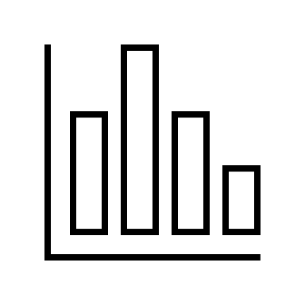

My Observation 3
Average
Price: $750,064.80
Average
Cost per Sq.ft: $476.33
Price
Highest : $10,000,000.00
Price
Lowest : $141,900.00
Average
Cost per Bedroom: $248,331.69
Average
Cost per Bathroom: $298,482.43

Slide 9
Graphs

Slide 10
Average price per Bedroom

Slide 11

Average price per Bath

Slide 12
Conclusion
the most affordable house is priced at 141,900 CAD. This budget-friendly option features one bedroom, one bathroom, and offers a cozy living space of 309 square feet. It's situated in the charming neighborhood of Whitehorn.
Looking at the broader picture, a significant 75% of the listed houses are priced below 850,000 CAD, offering a variety of choices for potential buyers.
On the other end of the spectrum, there are a total of 222 houses (comprising nearly 7% of all listings) that fall into the category of high-end properties. These upscale homes are priced between 850,000 and 1,520,000 CAD, with the most luxurious option reaching a maximum price of 10,000,000 CAD, located at Hillhurst with 3 beds, 3.5 bathrooms, and 4,715 sq.Ft.

